Slide 1
C.A.R. Example
Focused on “Customer Flavor Ratings” at Shef B. Foods

Slide 2
[CONTEXT]
Applying CAR Method @ Shef B. Foods
Context
  Shef B. Foods makes PB&H sandwiches, and recently gathered data on 48 experimental sandwiches.
  Company wants to find ways to improve the sandwiches, in terms of:
    Customer flavor ratings, speed of assembly, raw material costs
  Areas where they might find improvement:
    Chef techniques, bread brand, peanut butter brand, peanut butter type, sandwich temperature, raw material quantities/recipe
  What’s at stake:
    Profitability, customer loyalty, possibly not selling the best sandwich ever made…

Slide 3
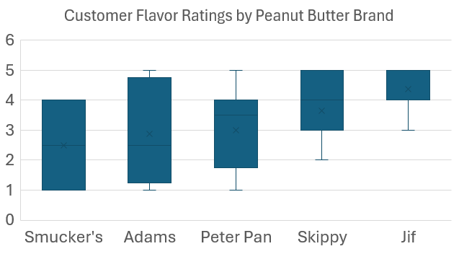
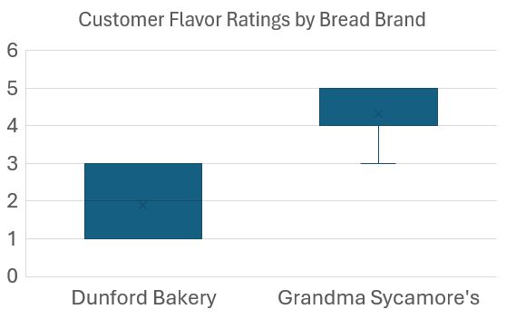
[ANALYSIS]
Applying CAR Method @ Shef B. Foods
Bread Brand and Peanut Butter Brand VS. Customer Ratings

Slide 4
[ANALYSIS]
Applying CAR Method @ Shef B. Foods
Sandwich Temperature VS. Customer Ratings

Slide 5
[RECOMMENDATIONS]
Applying CAR Method @ Shef B. Foods
Recommendations
  If we are just looking at Customer Flavor Ratings, we have the following recommendations:
    Shef B. Foods should use Grandma Sycamore’s bread and Jif peanut butter.
    Sandwiches should be served at a temperature between 80-90 degrees Fahrenheit
  We did not look at assembly times or raw material usage, and leave that to a future analysis – which could change our recommendations

