Slide 1
Outline
Motivation
Theories
New Model
Exploring Implications
So what?
Objectives:
Define motivation and its sources
Better understand how to create conditions of lasting motivation in self & others

Slide 2
Motivation
What is your best definition of motivation?
Process that elicits, controls and sustains behaviors
Nature, strength and persistence of behaviors
Extrinsic vs. Intrinsic

Slide 3
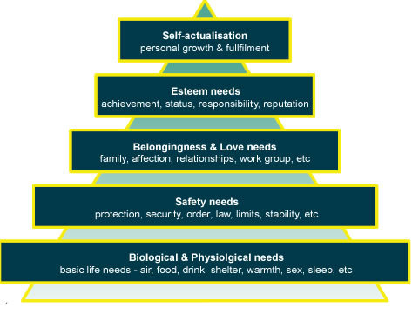
Theories
“A Theory of Human Motivation” (Maslow, 1943)

Slide 4
Theories
ERG Theory (Alderfer, 1960)
Growth
Relatedness
Existence

Slide 5
Theories
Theory X (McGregor, 1960)
Assumes people are lazy; want to avoid work
Highly controlled; micromanaged
Threats and coercion
Must have incentives
Mistrust

Slide 6
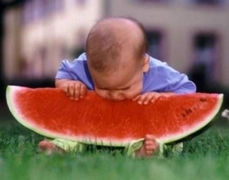
Theories
Theory Y (McGregor, 1960)
Assumes people are ambitious, self-motivated
Satisfaction comes from doing a good job
Shared decision making

Slide 7
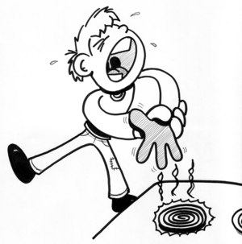
Theories
Reinforcement Theory (Skinner)
Individual’s behavior with positive consequences leads to repeated behavior
Individual’s behavior with negative consequences leads to non-repeated behavior

Slide 8
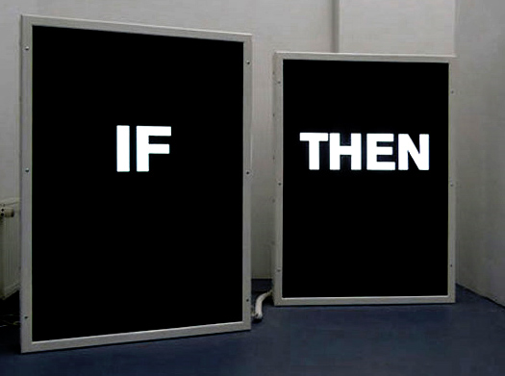
Theories
Expectancy Theory (Vroom, 1964)
Individuals act in a certain way based on expectancy of outcome, effort involved and attractiveness of reward
Explains behavior direction process, not what motivates individuals
Conditional
Calculating

Slide 9
Theories
Goal-setting Theory of Motivation (Locke, 1960)
Goal-setting linked to task performance
Challenging goals + appropriate feedback = increased quantity & quality of performance
Little to no evidence that goal-setting improves job satisfaction
Sometimes less buy-in
Summary of theories

Slide 10
New Model
List some of the influences that are trying to influence you to act
In what ways are you trying to influence different people in your life?
How, why and under what conditions do you . . .
Recognize these influences?
Assign positive & negative value to them?
Think others assign value to your influences?
Act on these influences?
Think others will act on your influences?
What is it that really causes us to
act on influences?

Slide 11
So what?
How do you define motivation? What are some of the sources?
In light of our discussion, what is at least one thing you will do differently in at least one setting to improve/create conditions of lasting motivation?

