Slide 1
Stress

Slide 2
Stress is defined as:
A state of mental or emotional strain or tension resulting from adverse or demanding circumstances

Slide 3
In America, the most common causes of stress are related to money, work, and family.
More woman report being stressed than men and twice as many woman than men are likely to be diagnosed with an anxiety disorder

Slide 4
So it is clear we all experience stress throughout our life and how we manage that stress impacts us in many different ways

Slide 5
We can categorize our stress into different ways:

Slide 6
Eustress: a positive stress, one that can be beneficial
OR
Distress: a negative stress, causes great amount of anxiety and/or other negative emotions (pain, sorrow, etc)

Slide 7
Can also be difined as:
Acute: lasts in the short term
OR
Chronic: lasts in the long term, long period of time

Slide 8
Chronic stress has been linked to high blood pressure, headaches, stomach upsets, and insomnia.

Slide 9
However, when we view our stressors in a different way it can trigger different physical responses.
When we recognize stress as something beneficial we are more likely to behave in a constructive way and when we view these stressors as challenges opposed to threats, it invites psychological responses that improve thinking and cause less wear and tear on the body

Slide 10
Before we can change the way we view stress, we must first identify our stressors.

Slide 11
Activity
List at least 3 stressors you are experiencing then classify them as eusttress or distress and acute or chronic

Slide 12
Stress | Describe the stressor in detail | Please mark one |  | Please mark one |  | Intensity Rating
 |  | Eustress | Distress | Acute | Chronic | Rate 1-5
Example | I’m stressed about using Google docs because I’ve never used them before. | x |  | x |  | 1
1
2
3
4
5
6
7
8
9
10

Slide 13
When looking at the ones you marked as distress, ask yourself “is it really a distress?”
Maybe finances are a stressor we marked as a distress, however, we could consider it in a different way and turn it into a eustress. I want a savings account, this eustress allows me to think of my purchases so I can save money

Slide 14
Now that we have identified our stressors….
Take a moment to reflect on the ways that you cope with your stress?
Do you go to the gym?
Do you clean your house?
Do you talk to a friend?
Scroll on social media?

Slide 15
Now take a moment to consider why you do these things.
A majority of the time we engage in these activities to avoid the discomfort from our stress. We do these to ignore, withdraw, or dismiss the stress we are facing. This is called regressive coping.

Slide 16
Its important to understand what regressive coping is as it can lead to negative emotions and added anxiety.

Slide 17
Now, that you have an understanding of regressive coping and what your biggest ones are, write down how effective this type of coping has been for you.

Slide 18
When we are facing stress, and we are engaging in these activities, we can take a moment to stop and ask ourselves “Is what I am doing helping or hurting me?”

Slide 19
When we take a moment to consider this question, we can evaluate if we are engaging with a regressive coping mechanism
If we are, this enables us to refocus our attention and tackle the stressor at hand

Slide 20
Just as how we view stress is important and affects us, the things we tell ourselves are just as important

Slide 21
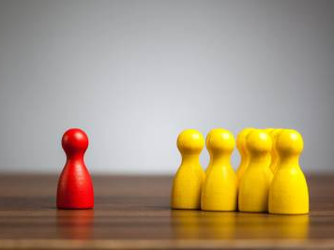
For a majority of us, we are our worst critic.

Slide 22
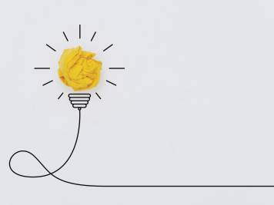
What we tell ourselves is what our brains believe. When we tell ourselves negative things we become our biggest barrier to success.

Slide 23
Due to this we need to change the things in which we tell ourselves…
This is why Positive Affirmations are so important!

Slide 24
https://youtu.be/3hE8eYGVwMU

Slide 25
Now that you understand the importance of positive affirmations, we are going to take a moment to make your own positive affirmations!

Slide 26
To begin…
Write at least two statements that you know to be true about you.

Slide 27
Next…
Write at least two statements you believe to be somewhat true about.

Slide 28
Lastly..
Write at least two statements you do not believe to be true but you wish they were.

Slide 29
Because positive affirmations are so important I want you to keep this list safe and read it to your self everyday!
Write them in your journal
Write them on a postcard and stick it to your mirror
Just put it somewhere you will read it everyday!

Slide 30
One last thing I would like to share…
A coping mechanism

Slide 31
Sometimes we become so riddled with racing thoughts and different emotions we constantly feel on edge and our anxiety is high

Slide 32
Something we can use to calm our anxiety’s is mindfulness meditation

Slide 33
What is mindfulness mediation?
https://youtu.be/g7yFvd7_KVw

Slide 34
Now I know what you are thinking…
I can’t meditate because I can’t sit still long enough, I can’t keep my brain quiet enough, I am too anxious to sit through a meditation….
Trust me…
These were the exact feelings I had too!
And at times in the beginning it is hard to sit still or quiet my mind
But it does become easier
And it has been such a great addition to my days!
This has become something I look forward to every morning as a way to get in touch with my intentions for the day

Slide 35
Lets practice a short one together.
I promise you wont regret it!
https://youtu.be/Fpiw2hH-dlc

Slide 36
What was your biggest takeaway from this?
Did you gain any insights or value?
will you try to do anything differently?

