Slide 1
MINDSETS
Fixed vs growth
Victim vs creator

Slide 2
Fixed vs Growth Mindset
Fixed Mindset: Belief is that intelligence is fixed, and that it can’t change or grow
This belief leads to a desire to “look smart” and therefore the tendency is for you to:
Avoid challenges
Give up easily when faced with an obstacle
View effort as fruitless or worse
Ignore useful, negative feedback
Feel threatened by the success of others
Students with a Fixed Mindset typically plateau early and achieve less than their full potential
How do students
have a FIXED mindset?
Notes:
REFERENCE C. Dweck here.

Slide 3
Fixed vs Growth Mindset
Growth Mindset: Belief is that intelligence can be developed.
This belief leads to a desire to learn and therefore to a tendency to:
Embrace challenges
Persist in the face of obstacles and setbacks
See effort as a path to mastery
Learn from feedback
Find lessons and inspiration in the success of others
Students with a Growth Mindset typically reach even higher
How do students
have a GROWTH mindset?
Notes:
REFERENCE C. Dweck here.

Slide 4
Victim vs Creator Mindset
Victim Mindset: Belief is that life happens to you and you have no choices
This belief leads to thinking you cannot have the life you want and leads you to
Blame others
Complain about your life
View effort as fruitless or worse
Make excuses for yourself
Repeat behaviors that reinforce feeling like a victim
Students with a Victim Mindset refuse to see and act on choices that would help them achieve the life they want.
How do students
have a VICTIM mindset?
Notes:
REFERENCE C. Dweck here.

Slide 5
Victim vs Creator Mindset
Creator Mindset: Belief is that you have multiple options to create the life you want
This belief includes accepting personal responsibility leading to
Seeking solutions
Taking action
Trying something new
Seeing failure as part of success
Developing grit and resilience
Students with a Creator Mindset accept responsibility for their choices and take action to create the life they want.
How do students
have a CREATOR mindset?
Notes:
REFERENCE C. Dweck here.

Slide 6
Let’s be honest. . .
No one makes Creator mindset choices all
the time. Our inner lives feature a perpetual tug of war between the Creator part of us and the Victim part of us.
But, if you believe that someone or something out there, outside yourself, causes all your problems, then it’s up to “them” to change. Can you afford to give your life over to someone or something else?
Downing, OnCourse, Cengage, 2017

Slide 7
Is it outrageous to believe that you create everything in your life? Of course it is.
But, here’s a better question:
Would it improve your life to act as if you create all of the outcomes and experiences
in your life?
YES!
Downing, OnCourse, Cengage, 2017

Slide 8
The more choices we make as Creators, the more we improve the quality of our lives.
Choose more often as a Creator.
It won’t be easy, but it is worth it.
(Downing, OnCourse, Cengage, 2017)

Slide 9
If you want to succeed in college and in life,
having a Creator mindset gives you a big edge.
(Downing, OnCourse, Cengage, 2017)

Slide 10
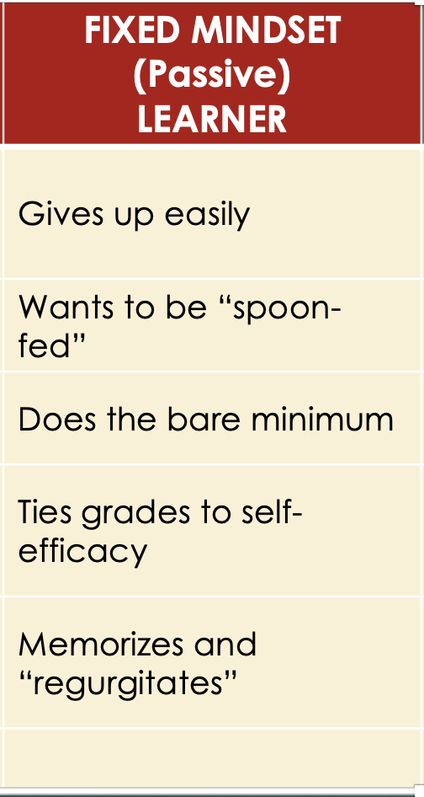
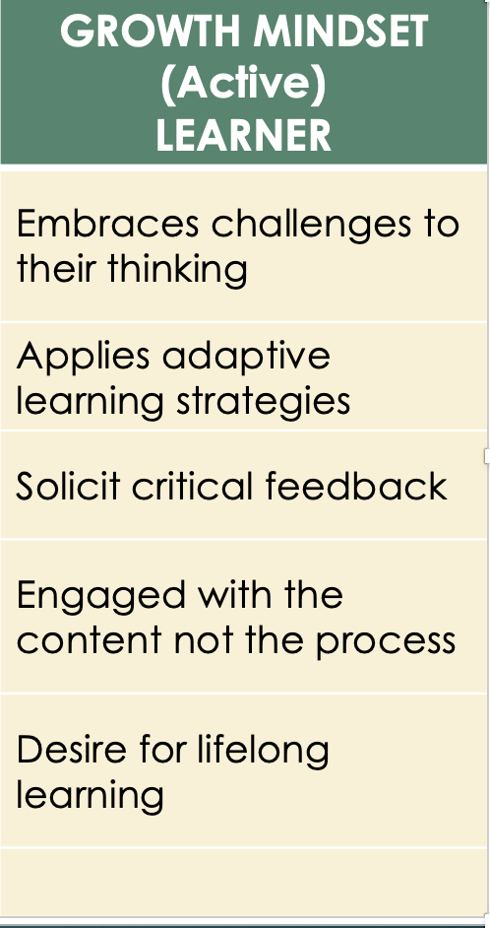

Slide 11
GROWTH/CREATOR Mindsets Generate Active Learning and Studying Practices
Increases your awareness of yourself as a learner, not as a ”performer
Are often framed around simple questions
Why?
How?
What if?
Have a reflective component—you actually think about what you are thinking and studying
Recognizes psychological factors such as your motivation and desire to learn, how you feel (your emotional state), physical and mental energy levels, and. . .self-efficacy--whether or not you believe you can achieve what you want to

